Slide 1

Work Out App
CMP 430 Final Project
Brought to you by: Enrique Cuapio, Shirley Polanco, Ana Leonardo, Ovis Delossantos, and Crismery Mejia.

Slide 2

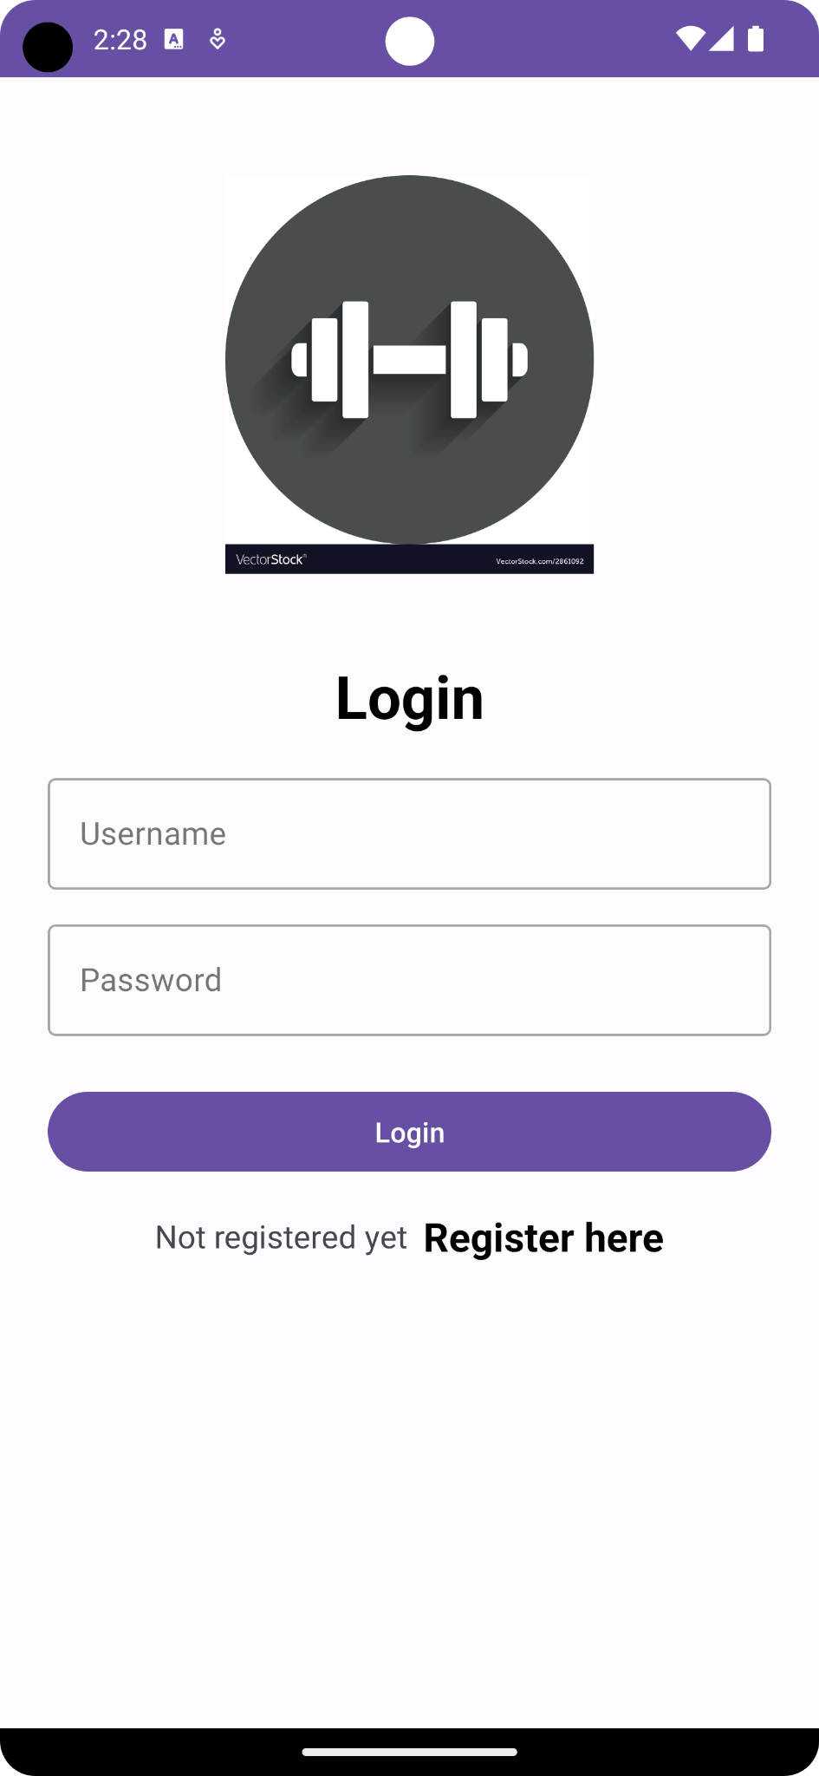
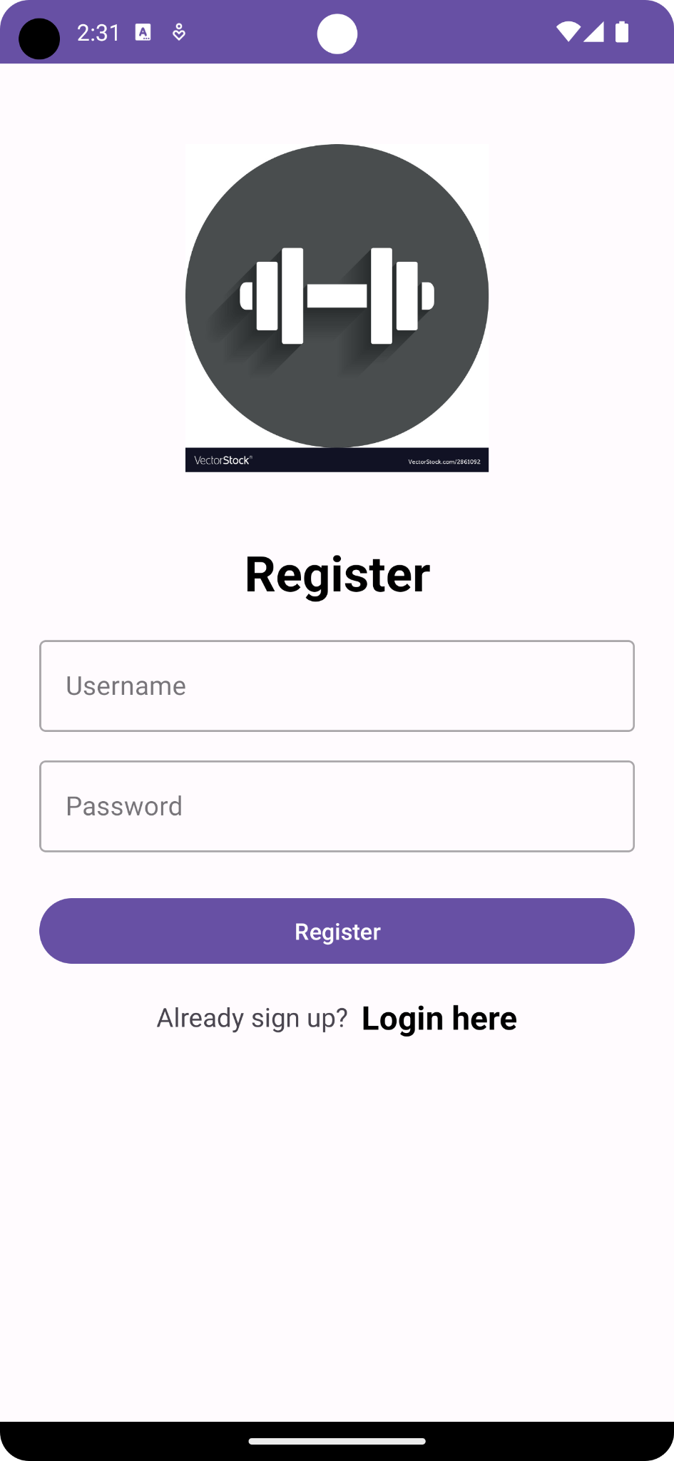
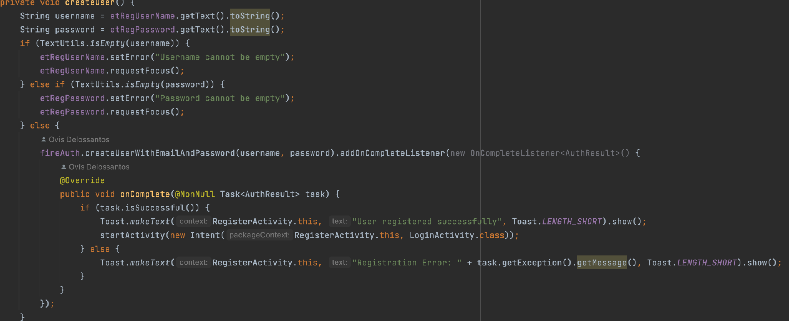
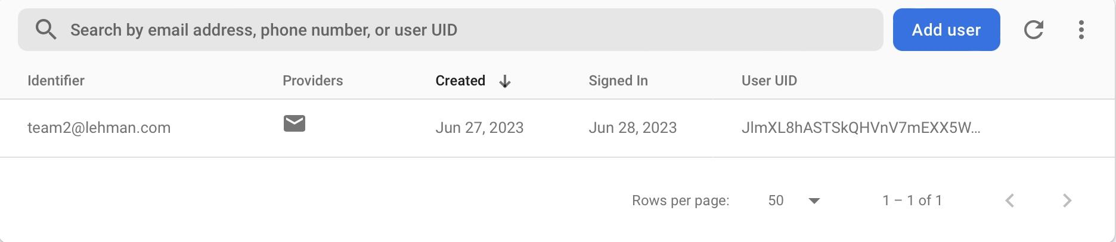
Login/Registration
Created two identical activity called LoginActivity and RegisterActivity
With the help of Firebase it allowed users to either login to the app or register if the user did not have permission
Bottom picture shows a successful account creation that a user can use to login

Slide 3
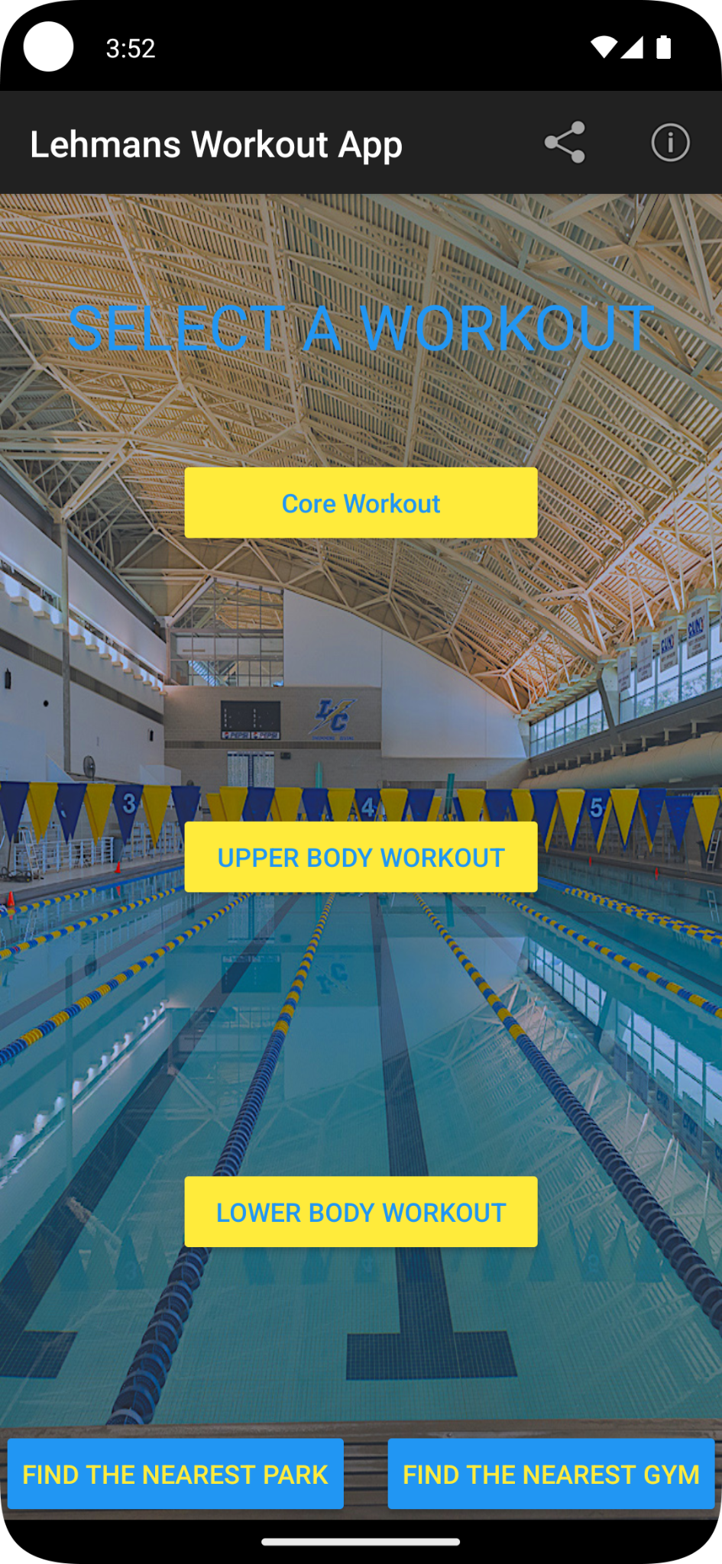
Menu
My work consisted on constructing an interface that would give the user the ability to take control of all of the apps features.
It would contain:
A menu: that would provide the user with the ability to invite friends to come join their workout. The menu also provides a description as to what the app offers and the apps purpose.
The Workout choices: varying from stretches, upper body workouts and lower body workouts. (Buttons)
A location intent function: that would give the user the nearest gym/park.

Slide 4
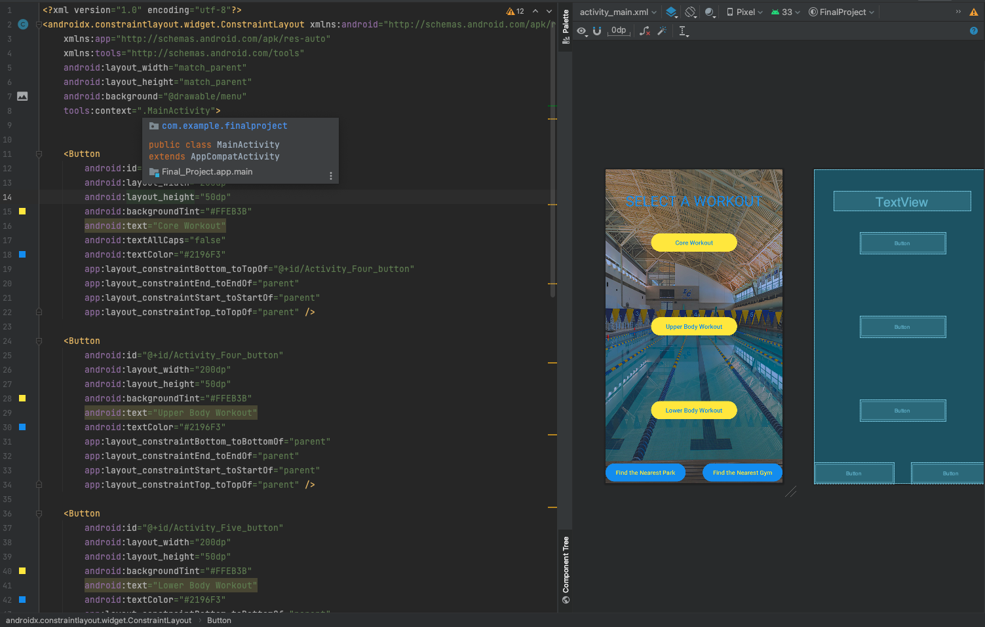
Menu
While the main XML file was a simple constraint layout with 5 buttons and a textview

Slide 5
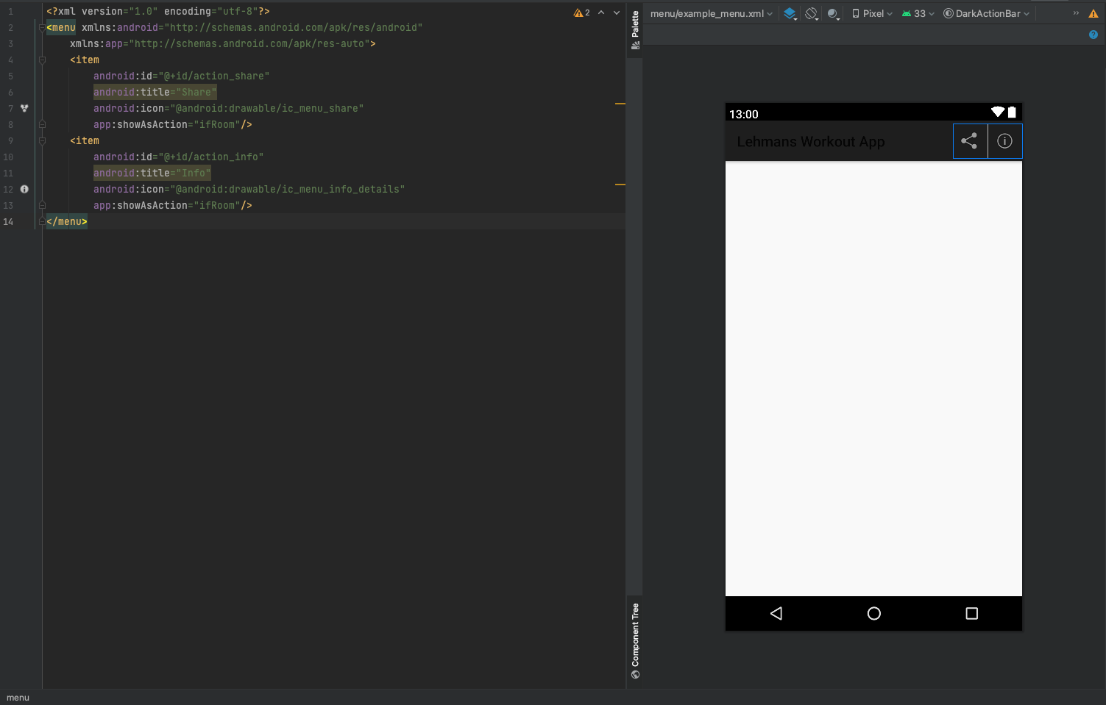
Menu
While the main XML file was a simple constraint layout with 5 buttons and a textview, I did create another activity to display the menu widgets.

Slide 6
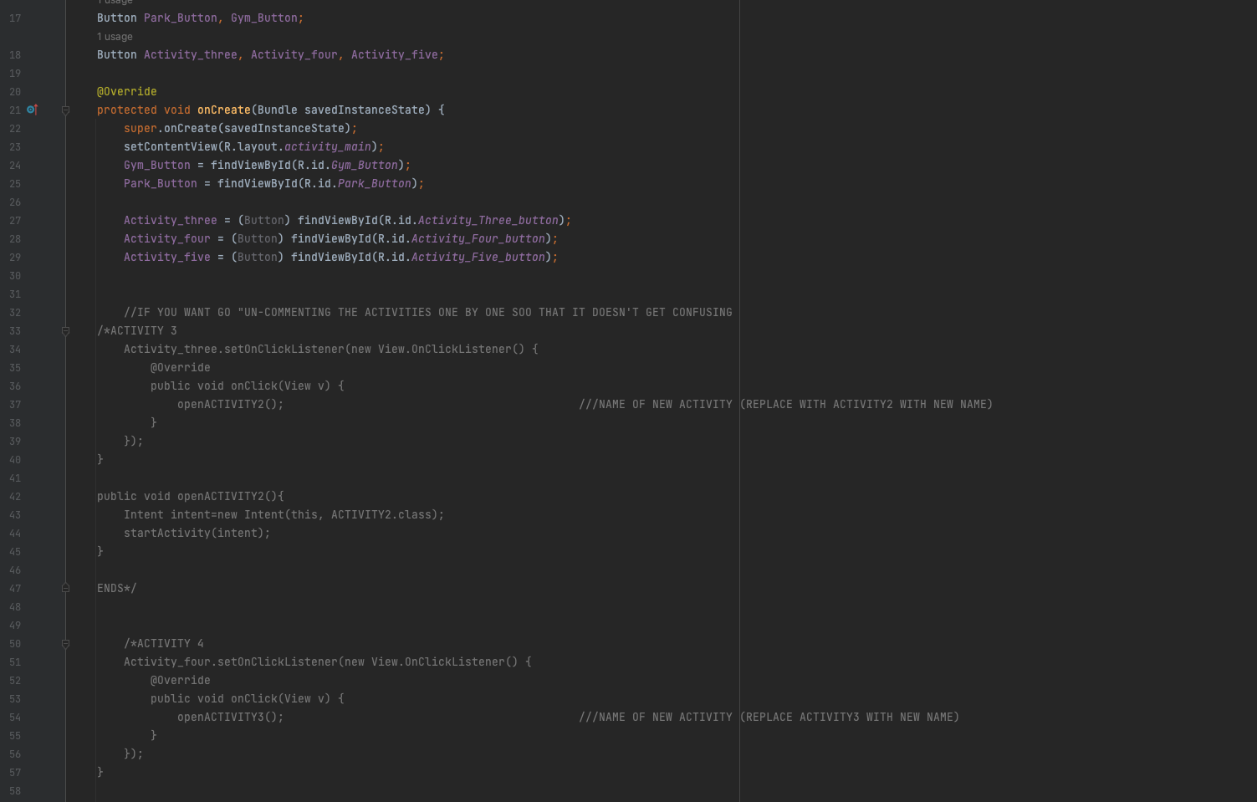
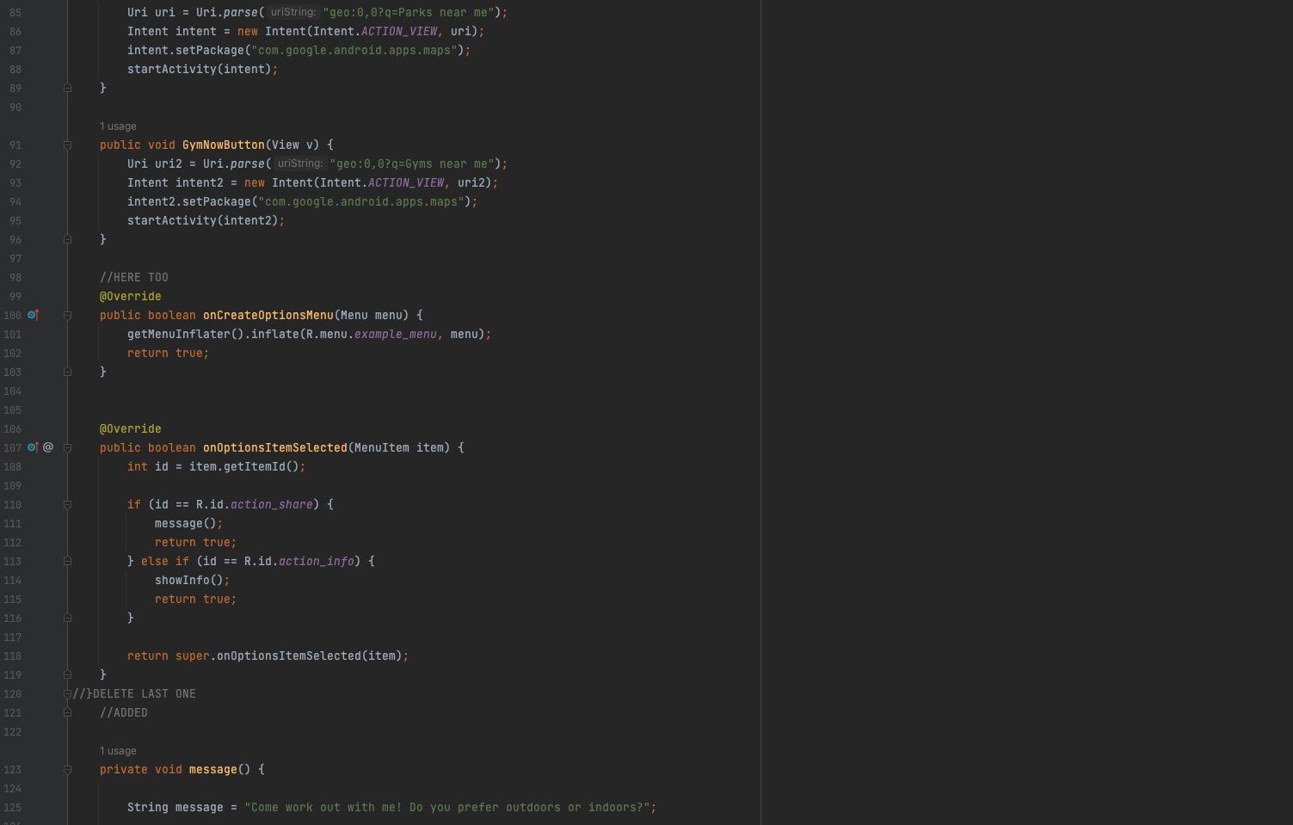
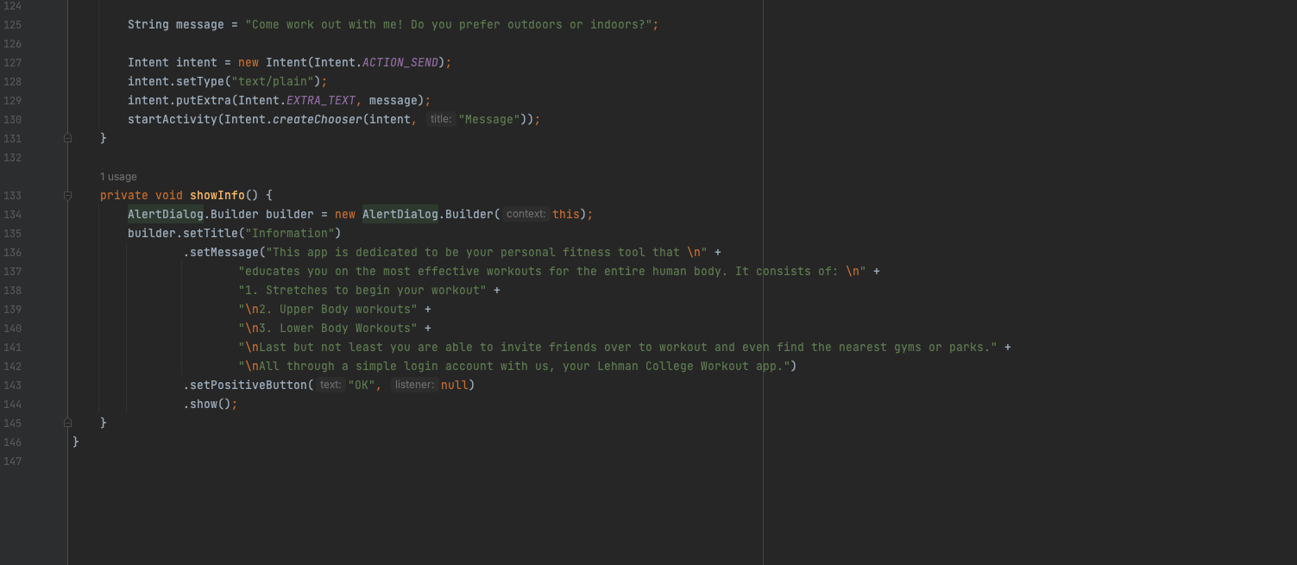
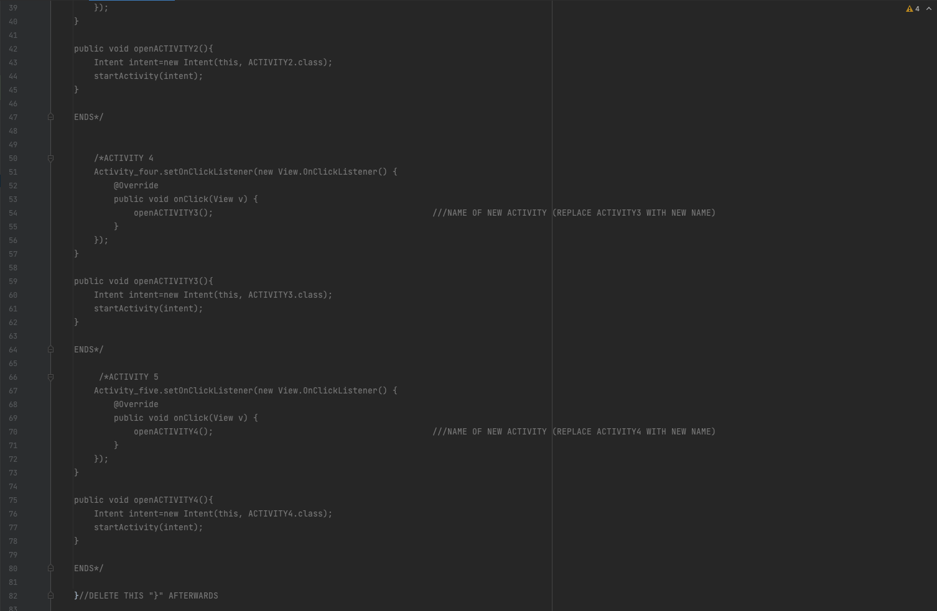
Menu
Due to the fact that Android studios does not allow others to work on the same project, we had to format our individual parts to be easily linkable (activities). Some of these adaptations can be seen in my individual project.

Slide 7
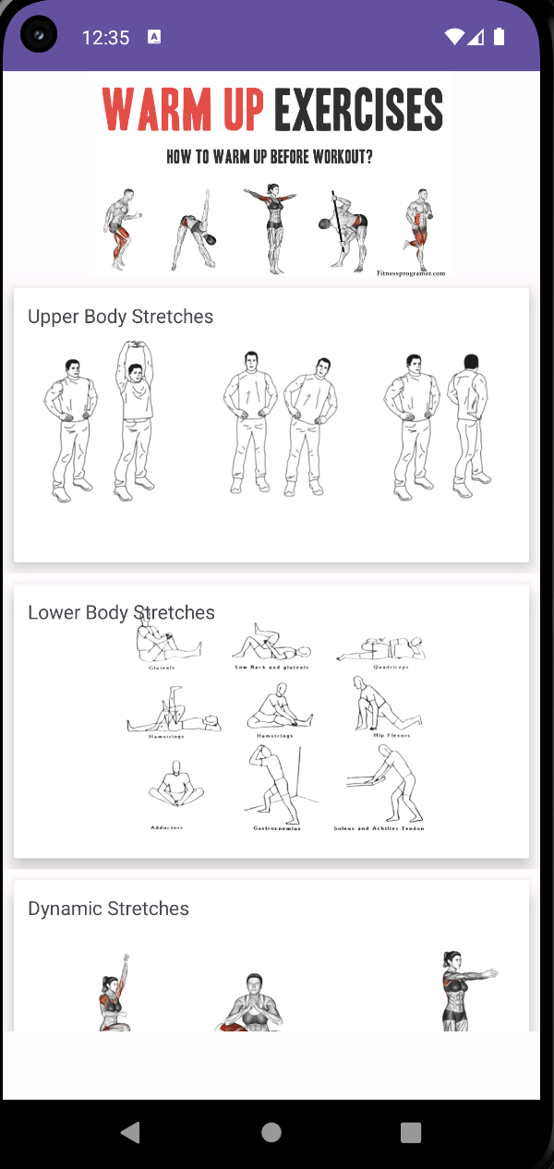
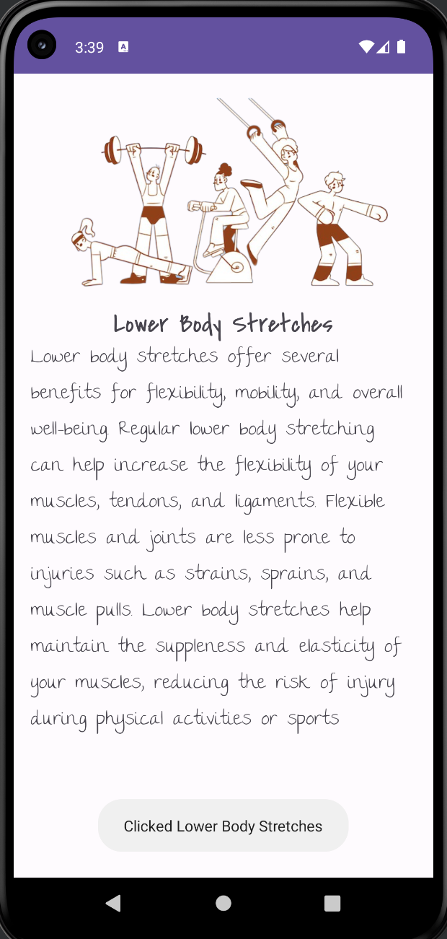
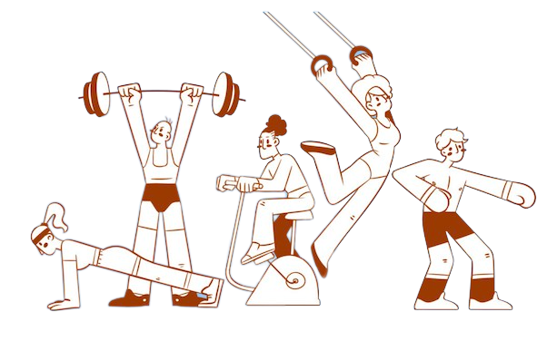
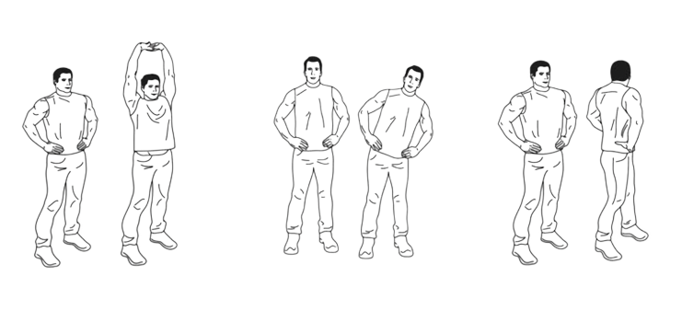
Stretches

Slide 8
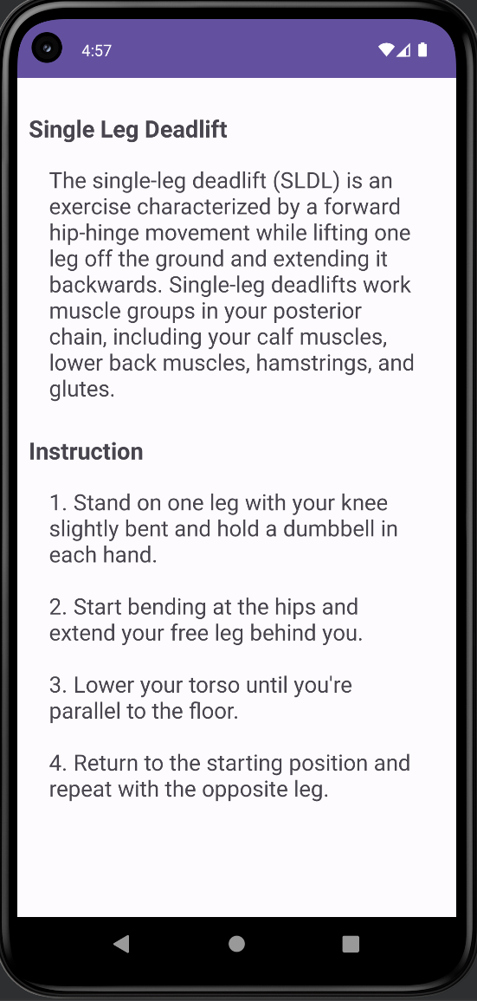
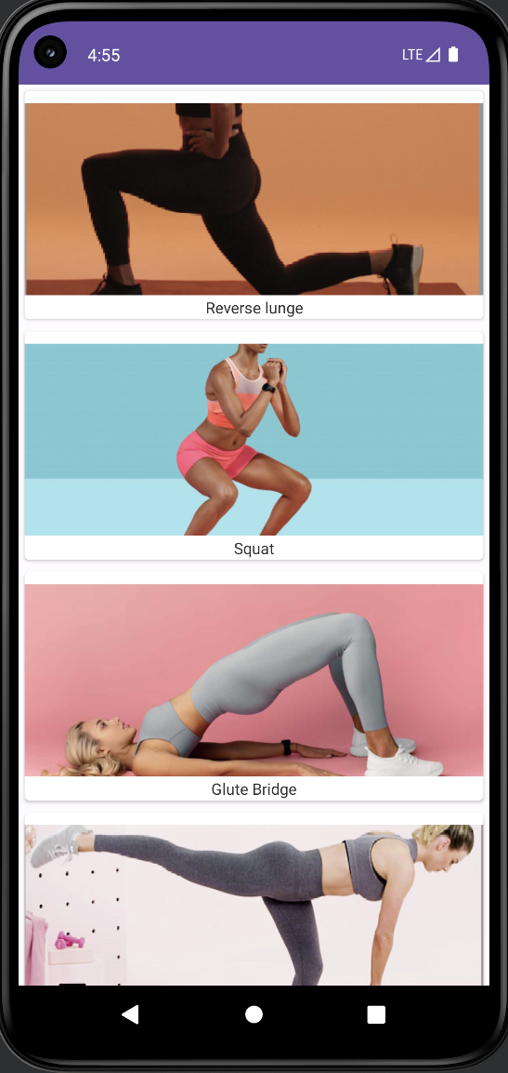
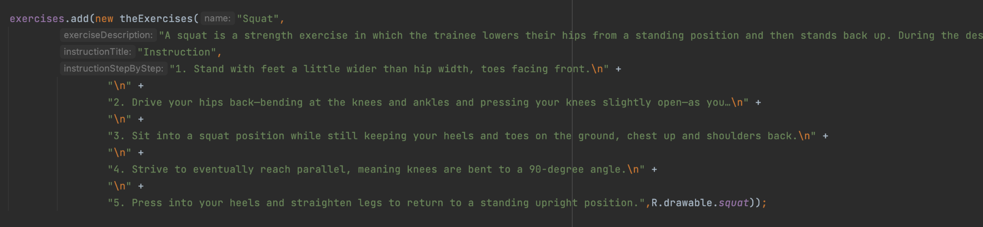
Lower Body
My responsibilities included a recyclerView and CardLayout. This is an ArrayList that contains all instances of theExercises class, which is stored, and there are many different instances similar to this one that is for the other exercises with their images added that are used for the CardLayout.

Slide 9
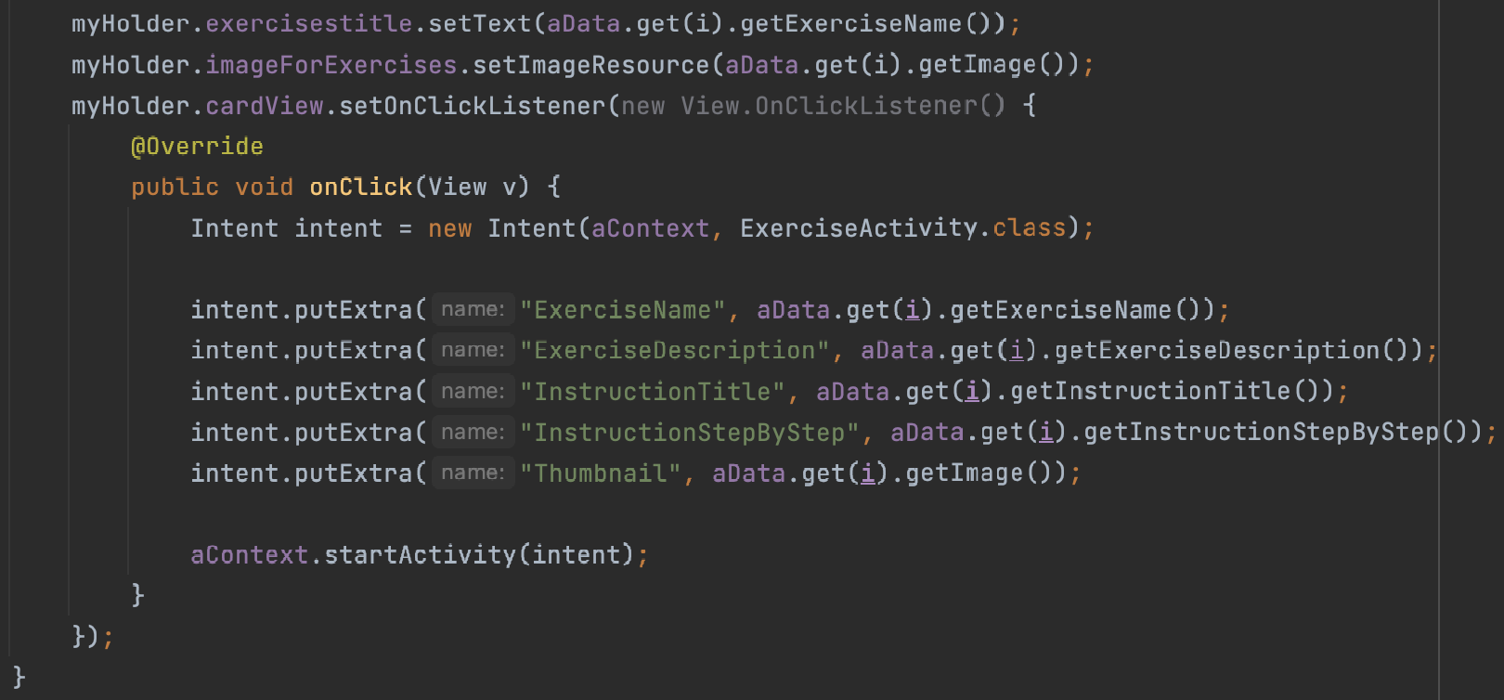
Lower Body
This code is from the RecyclerViewAdapter, which is an on-click listener on the cardView will be activated when the cardView is clicked. Then the onClick method will be executed, where an intent is created, which will start the ExerciseActivity. All the needed data for the current cardView will be passed as extras to the intent. This is the reason why it is displayed, and you are able to see all the information of the current exercise when it is clicked.

Slide 10
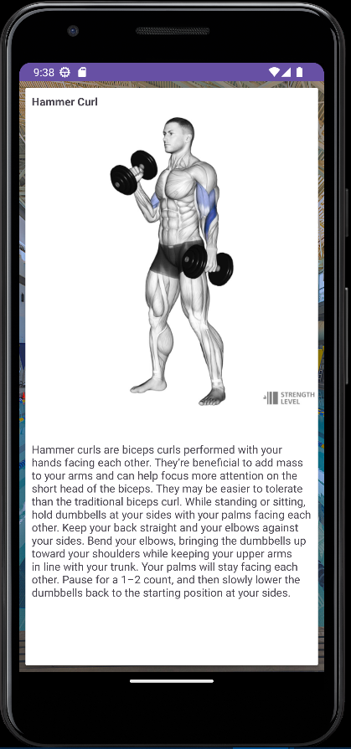
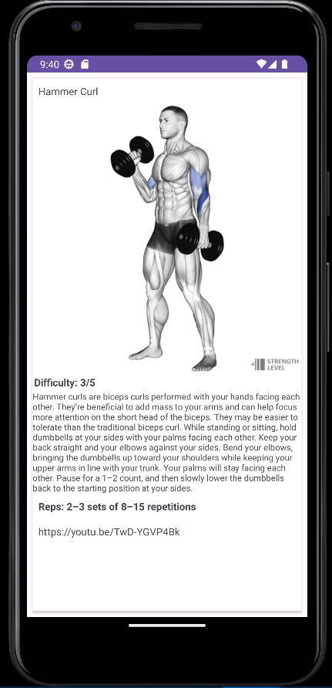
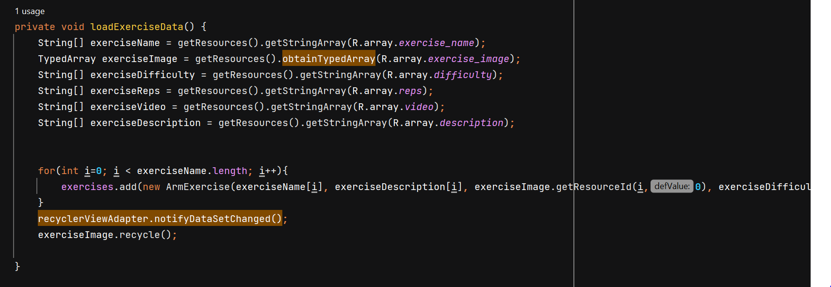
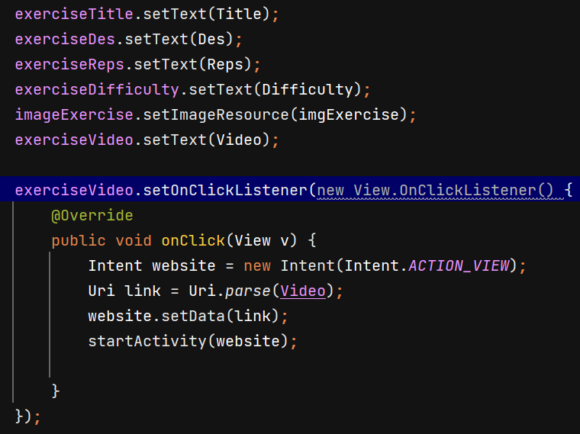
Arm Exercises- Shirley
Implemented Recyclerview and put in arm workouts.
Displayed exercise information as well as difficulty, reps, description, and youtube link.
Set up Recycler adapter to take in multiple String Arrays and multiple arm exercise objects.
Created an onLongClickListener so that when finished with a workout, it can be removed.
Created a clickable youtube link that sends you to a video that shows you the workout and how to perform it.

Slide 11
Proud Accomplishments
Being able to make compromises (while working in a group, we had to make many decisions, which led to a lot of disagreements, but in the end, we were able to make the decisions that would benefit this team the most and satisfy everyone).
Time management (since this is a summer course, the work needs to be fulfilled at a much faster pace which meant that we needed to manage our time to the best of our ability and select times outside of class when we were all able to meet on zoom to work on this project in order to be able to complete it).
Being able to combine all of our individual work together (in the process of combining our work, bugs started to occur that needed to be fixed in order for our app to be able to run).
Being able to communicate efficiently (to make sure that everyone is on the same page and understands their responsibilities in the group).
Determination (since we all had to push each other through obstacles that were encountered and not give up no matter how frustrating it became at times).

Slide 12
Challenges
Some of the challenges we faced during this project were towards the end. These included but are not limited to:
Although we had individual flaws, this entire project consisted of learning and research in order to fit and check off the criteria points. For example, Ovis had to learn how to use a database in order to create our login feature. We each had to learn how to do certain layouts that would facilitate the users experience, etc).
We had a hard time sharing our individual code and even once we established github as our main source of sharing, we still had to make sure all our file names were formatted correctly.
We had to run our project an infinity amount of times when any small modification was done, which cause sometimes our project to crash.
We were learning while constructing this project, meaning we had Mini projects due at the same time. This caused our project to perhaps not be up to our own standards as time was not on our side.
We had to make our project look and check every criteria point which sometimes we missed and had to go back to retweak our code. Being that Ovis was the one running our project we had to explain and guide him on the files he was to change.
We had to record our presentation and record our individual slides in order to fit a certain time mark (1 minute per persons slides). In other words, we had to prepare for our presentation which led to us reunited outside of class time.
Overall, we had a group of 5 very intelligent beings who were very committed which facilitated all of these challenges faced. Thank You!

Slide 13
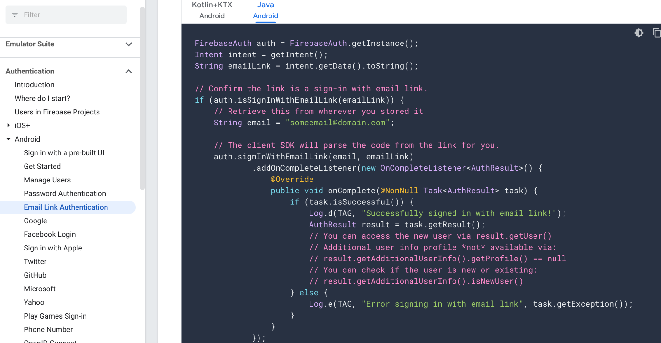
Lessons Learned
FireBase is a great tool to use.
Great template to use if someone wants to create their own app that needs verification
Analytics that FireBase provides
So much still left to understand

Slide 14
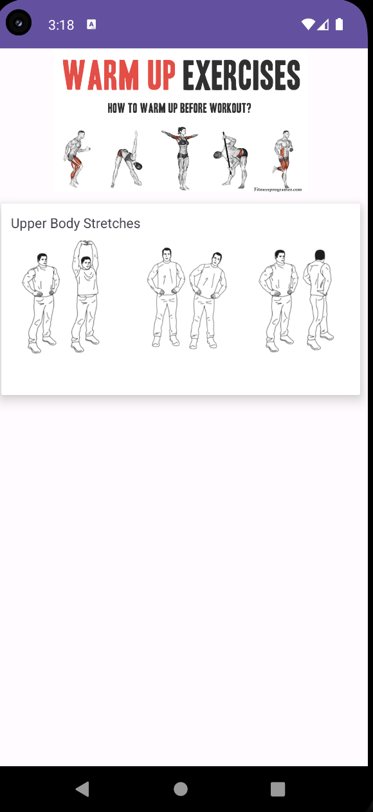
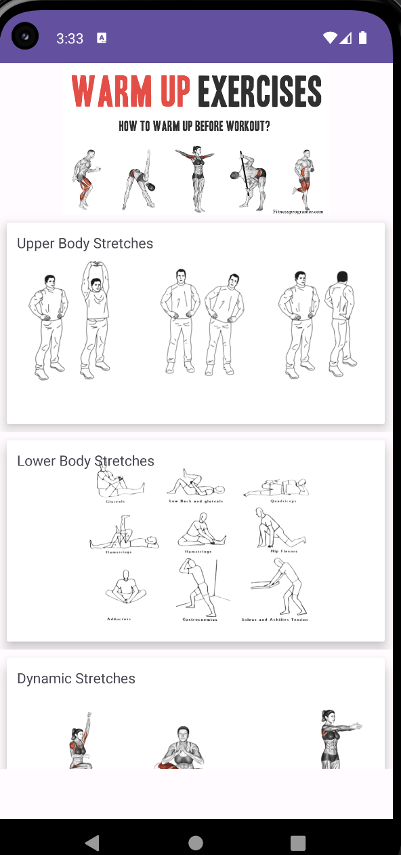
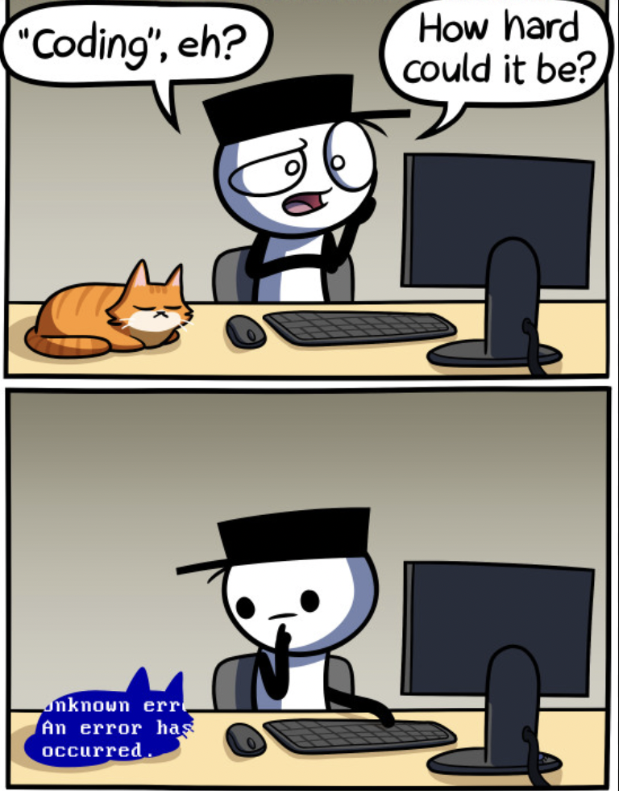

Clarity of Hindsight
android:layout_width="match_parent"
android:layout_height="wrap_content">

Slide 15
Conclusion
In conclusion we implemented activities, implicit and explicit intent, used menus and recycler views as well as firebase to establish a gym app that displays different exercises such as stretches, upper body, and lower body workouts. Through our challenges in putting the project together, we succeeded in displaying a log-in page asking a user for their name and password, menus for respective workouts, maps to find the nearest gym/park and toasts and a message when someone is done with their stretches. Overall, despite our difficulties, we worked together as a team and got our gym app functioning well.

